Slide 1
Social Science Research Methods
Stephanie Dietz

Slide 2
Opening Thought
Why should engineers or people in your field of study learn social science methods?

Slide 3
Descriptive Research

Slide 4
Observational Research Design
The researcher observes and systematically records the behavior of individuals in order to describe the behavior.

Slide 5
Types of observational research
Behavioral observation: direct and systematic recording of behaviors, usually in a natural setting.

Slide 6
Types of observational research
Issues:
Behaviors disrupted by observation
Subjective interpretation
Observational Exercise

Slide 7
Observational Research
Habituation: getting used to observer’s presence.
Setting up behavior categories to categorize counted behaviors.

Slide 8
Observational Research
Content analysis: using techniques of behavioral analysis to look at occurrence of specific events in media.

Slide 9
Observational Research
Archival research: using historical records to measure behaviors.

Slide 10
Types of Observations
Naturalistic observation: researcher observes behavior in a natural setting as unobtrusively as possible.

Slide 11
Types of Observations
Participant observation: researcher engages in activities to observe and record behavior of individuals.

Slide 12
Types of Observations
Contrived (structured) observation: setting is arranged to elicit target behavior.
Structured Observation

Slide 13
Survey Research Design
Survey research design: uses a survey to obtain a description of a particular group.

Slide 14
Survey research design
Name | Definition | Advantages | Disadvantage/Issues | Example
Open-ended | Allows participants to respond in their own words. | Reveals individuals’ true thoughts or opinions | 1. Different perspectives 2.Difficult to summarize or analyze | What is your favorite pet type?

Slide 15
Survey research design
Restricted | Gives participants limited responses. (multiple choice) | Easy to analyze and summarize | 1. Might not have all answers. | What is favorite pet type: Dog Cat Bird

Slide 16
Survey Research Design
Rating-scale | Gives participants Pre-determined scale | Easy for participant to Understand Allows for measurement on interval scale | 1. Response Set: Answer the same for all 2. Debate about interval scale.

Slide 17
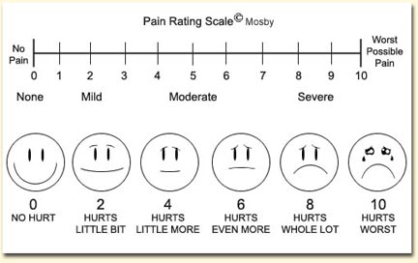
Survey research Design

Slide 18
Administering a survey
Mailed Surveys
Convenient and anonymous
Non-threatening
Easy to administer

Slide 19
Administering a survey
Mailed Surveys
Can be expensive
Low response rate
Unsure who completes the survey

Slide 20
Administering a survey
Non-response bias: people who return surveys are not usually representative of population.

Slide 21
Administering a survey
Telephone Surveys
Conducted from home or office
Cheaper (no paper involved)

Slide 22
Administering a survey
Telephone Survey
Time Consuming
Interviewer Bias: researcher influences natural responses.

Slide 23
Administering a survey
Internet Surveys
Efficient to administer
Access to large number of people
Survey can be individualized

Slide 24
Administering a survey
Internet Surveys
Expense for site (not always)
Sample may not be representative
Cannot control who sees/takes survey

Slide 25
Administering a Survey
In person survey
Efficient to administer in groups
100% response rate
Flexible (groups or individual)

Slide 26
Administering a Survey
In person surveys
Time consuming
Interviewer bias

Slide 27
Experimental Research Strategy

Slide 28
Experimental research strategy
The goal of the experimental research strategy is to demonstrate a cause-and-effect relationship between two or more variables.

Slide 29
Experimental research strategy
The following four basic elements must be present (for experiment status):
Manipulation
Measurement
Comparison
Control

Slide 30
Experimental research strategy
The variable that is manipulated/changed is called the independent variable.
Specific conditions are called levels.

Slide 31
Experimental research strategy
The variable that is measured is called the dependent variable.

Slide 32
Experimental research strategy
Trying to demonstrate that changes in the independent variable are responsible for changes in the dependent variable.

Slide 33
Experimental research strategy
A researcher is interested in the effects of exercise on weight. He creates a new exercise program that targets certain body areas. Each participant’s weight is measured at the beginning of the study. The researcher then has the participants either participate in the new program, or do nothing. Weight is then measured 6 weeks later, comparing the two groups.

Slide 34
Experimental research strategy
A developmental psychologist is interested in the effects of age on color preference. She recruits people of three different age groups:10-15, 16-20 and 20-25, and asks them to rank five different colors: red, blue, green, white, and black. The preferences are then compared among the age groups.

Slide 35
Experimental research strategy
A clinician is interested in looking at how gender and a new therapy are related in terms of depression scores. All participants are given a depression test. The researcher splits the groups into male and female. Each group is then split into treatment/no-treatment groups. Depression scores are then measured again, and compared among the groups.

Slide 36
Experimental research strategy
All other variables in the study are called extraneous variables.

Slide 37
Experimental research strategy
May become a confounding variable if systematically changes with dependent variable.

Slide 38
Experimental research strategy
A researcher is interested in the effects of off-topic discussion in a classroom on attention. He has one classroom that is taught as normal, and a second in which two confederates chat in the back during the lecture. Scores on a “pop quiz” are then taken, and compared between the two classes.

Slide 39
Conditions for cause and effects
Time-order of independent /dependent variable
Independent must come first
Covariance of independent and dependent variables
Must correlate with each other
Exclusion of confounding variables

Slide 40
Problems with causation
Third variable problem: occurs when a third variable is related to both the independent variable and the dependent variable, and is responsible for the changes in both. (Confound!)

Slide 41
Problems with causation
Directionality Problem: Can be unknown if independent caused dependent or dependent caused independent.

Slide 42
Problems with causation
Setting of experiment: Unknown if findings of study extend beyond “unnatural” setting.

Slide 43
Elements of an experiment
Manipulation:
Determine which variable to manipulate
Create series of treatments with different IV values

Slide 44
Elements of an experiment
Helps to solve the directionality problem by allowing for systematic changes in only one variable.

Slide 45
Elements of an experiment
Helps to solve the third-variable problem by allowing for a means to test for it.
Can manipulate third-variable to test for changes in dependent variable

Slide 46
Elements of an experiment
Control: Experiments control all other variables outside IV and DV.

Slide 47
Elements of an experiment
Helps to solve the third-variable problem by allowing for consistency among levels of IV.

Slide 48
Elements of an experiment
How to control extraneous variables:
Hold constant: Keep the variable the same for all participants. (Only use women, only use 5-year-olds, etc.)
Matching: Keep the variables the same between levels. (Same number of men and women in each group, same number of 1st and 2nd graders in each group, etc.)
Randomization: Place people into groups randomly to prevent systematic placement into groups.

Slide 49
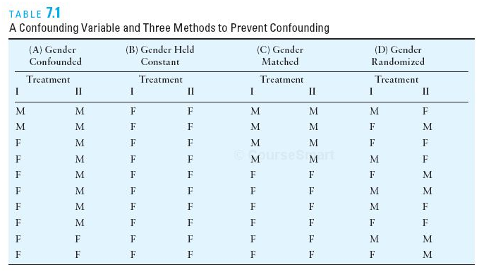

Slide 50
Groups of an experiment
Experimental group: Group that experiences the manipulated independent variable (treatment).

Slide 51
Groups of an experiment
Control group: group that does not experience manipulated independent variable (treatment).

Slide 52
Groups of an experiment
Control groups
No-treatment control group: participants do not receive any treatment/manipulation.
Placebo group: participants receive a placebo version of the treatment/manipulation (sugar pill, off-topic test, etc.)

Slide 53
Correlational Research Design

Slide 54
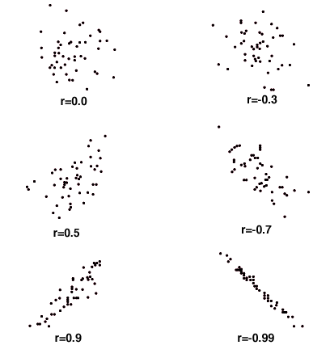

Slide 55
Pearson Correlation
Significance of the relationship: significance indicates that the relationship was not due to random variance (is a relationship).

Slide 56
Pearson Correlation
Significance does not measure how strong the relationship is.

Slide 57
Pearson Correlation
r²: co-efficient of determination.
Measures how much of the variance of one variable is predicted by the second variable.
Square of correlation

Slide 58
Correlational Research vs. Experimental Research
Correlational research demonstrates the existence of a relationship.
Correlations cannot answer why the relationship exists.
Third-variable problem

Slide 59
Correlational Research vs. Experimental Research
Experimental research demonstrates the causality of a relationship.

Slide 60
Uses of correlational research
Prediction: future behavior and level of second variable
Reliability
Validity
Theory Evaluation

